Slide 1
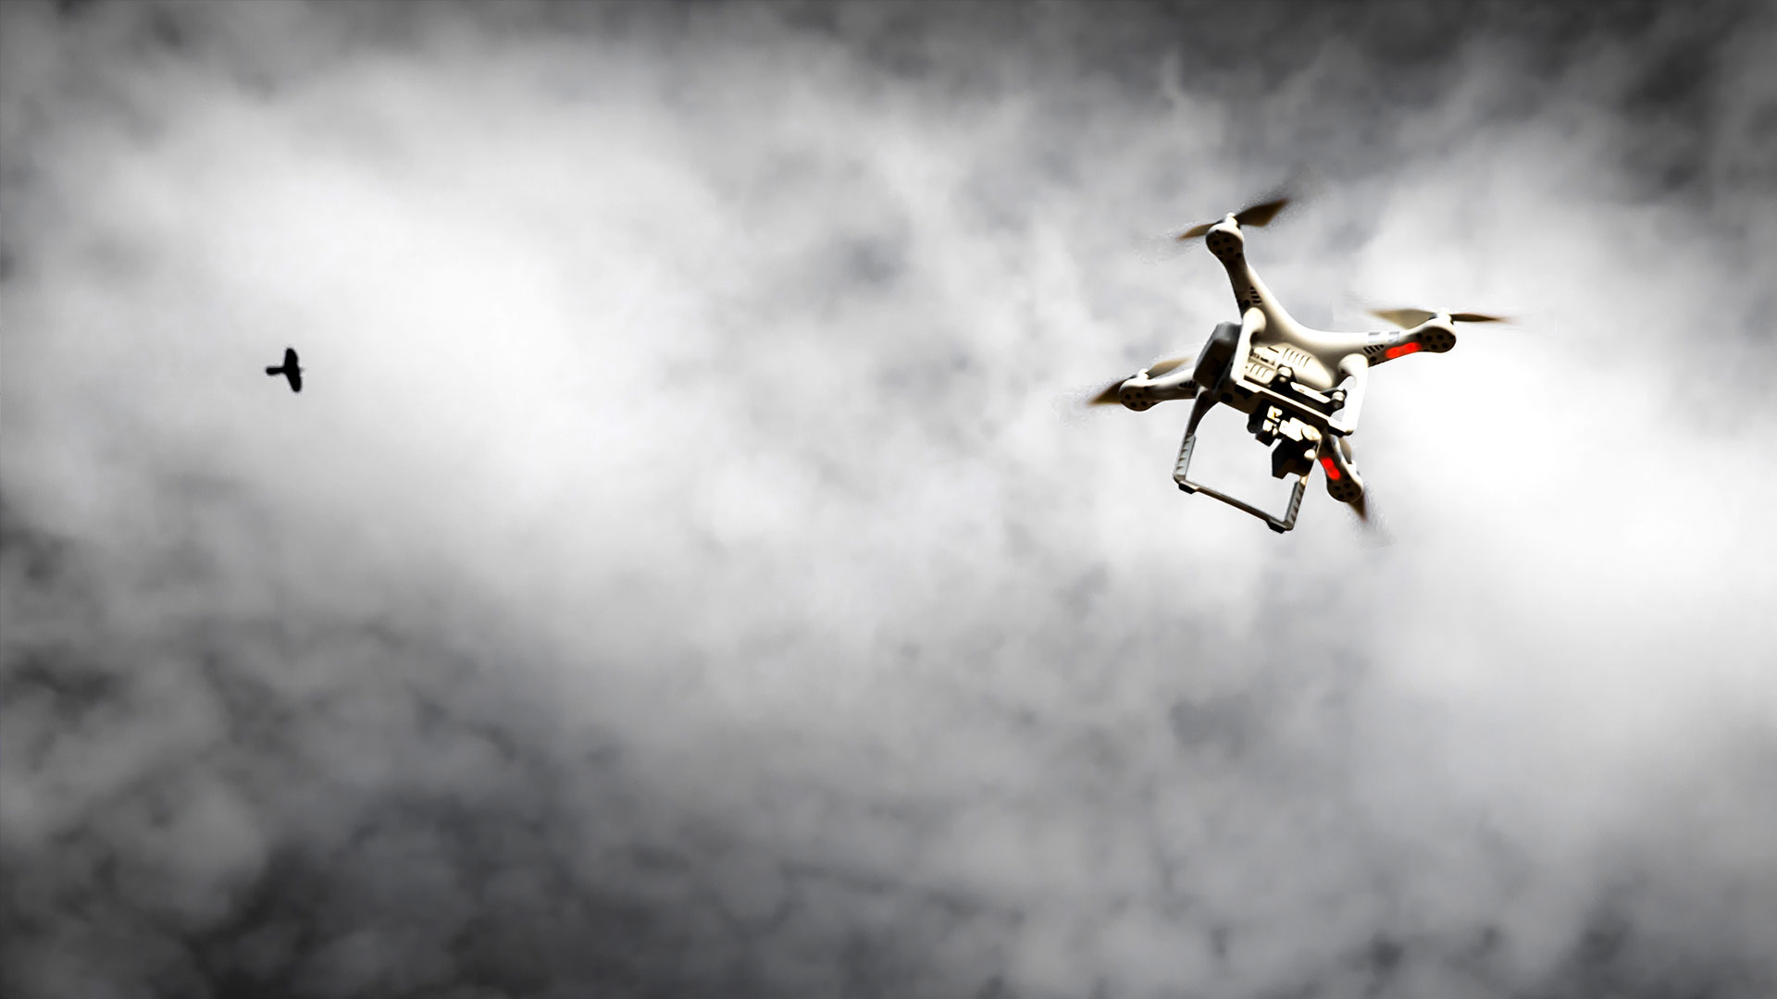

Face detection by phantom 4pro+ aircraft in real time
UNIVERSITY OF SALERNO
DEPARTMENT OF INFORMATICS
Master’s Degree in Information Security
PROJECT OF BASICS OF ARTIFICIAL VISION AND BIOMETRICS
Supervisors
Prof. Michele Nappi
Dr. Luigi De Maio
Students
Francesco De Feo
Roberto Contaldo
Sara Zaino

Slide 2
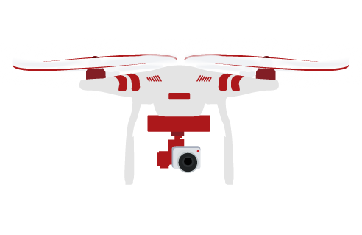
Outline
Motivations and goals
Face detection by Viola Jones
Experiments and Results
Problem Faced & Solutions
Final implementation
Conclusions

Slide 3
Outline
Motivations and goals
Face detection by Viola Jones
Experiments and Results
Problem Faced & Solutions
Final implementation
Conclusions

Slide 4
Motivations and goals

Slide 5

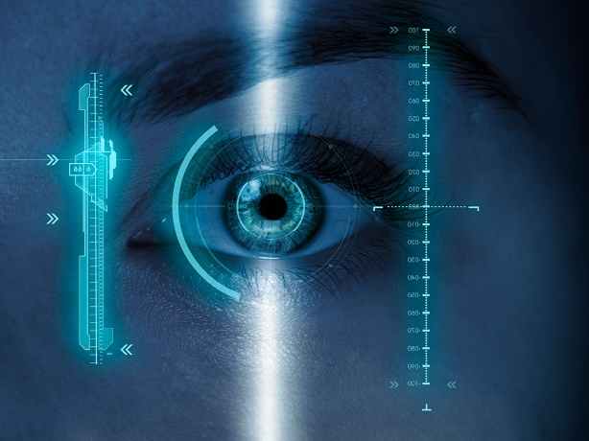
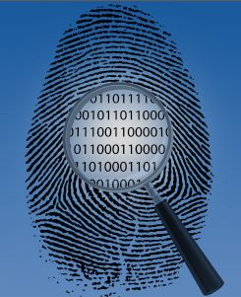
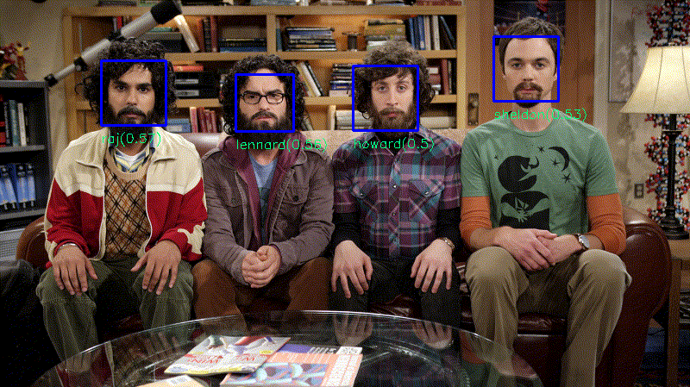
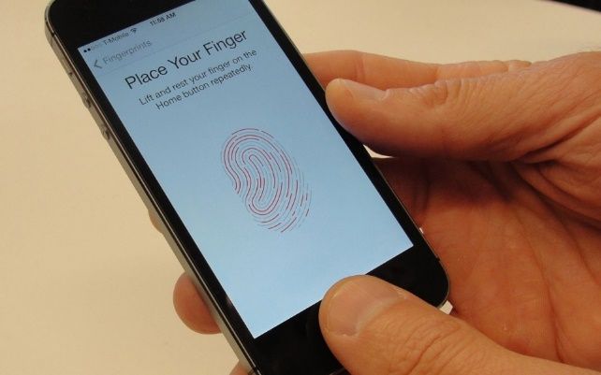
Motivations and goals
Security&Biometrics

Slide 6
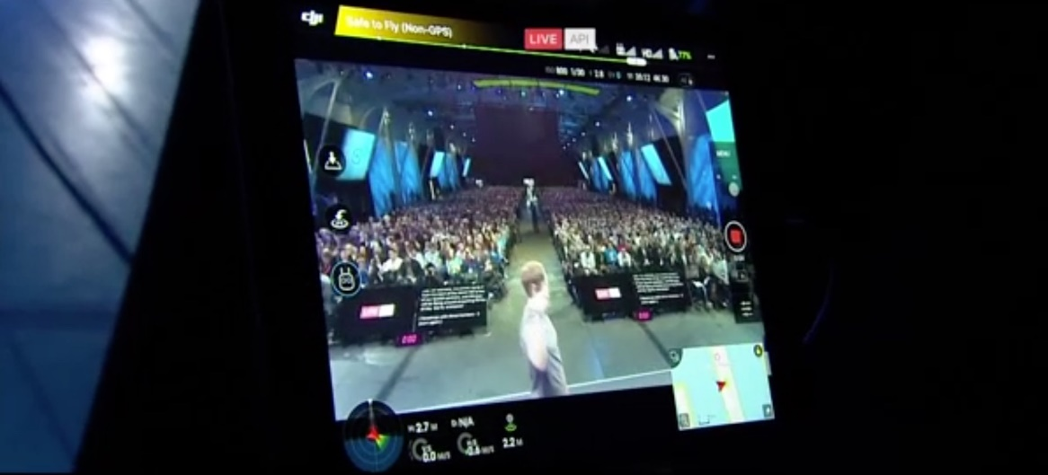
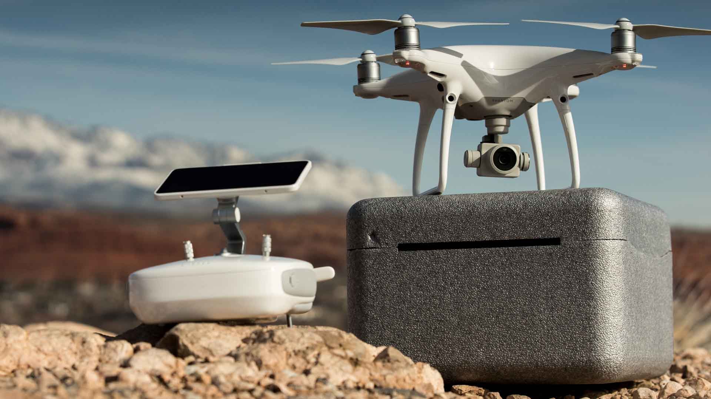
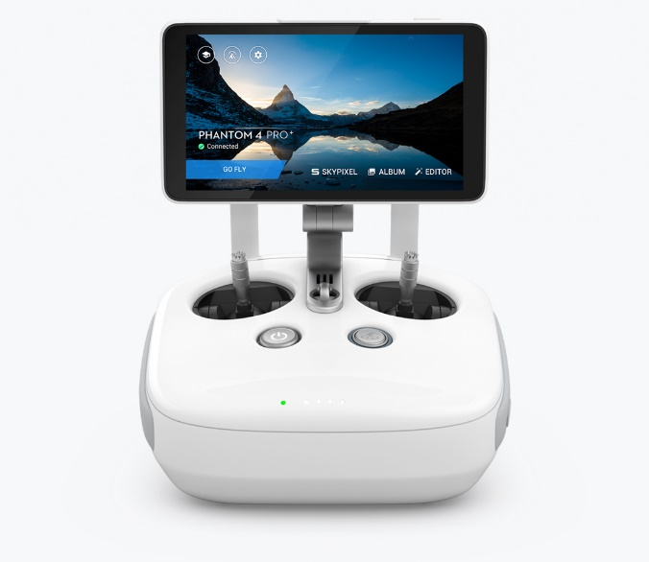
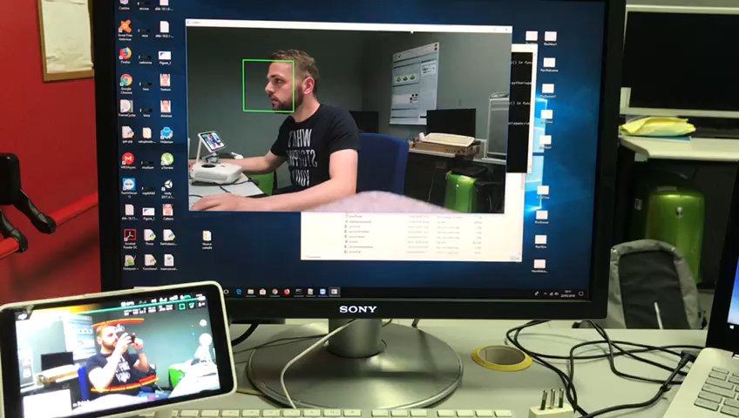
Motivations and goals
Security&Biometrics&Drone

Slide 7
Phantom 4 Pro+
Released in November 2016
Has a three-axis stabilized camera
Five directional sensors
Control range 7 km
Speed 72 km/h
Video resolution 4K 60 fps
Offers two remote controllers, one with a dedicated
screen and one without
Live streaming by DJI Go 4 app with platform: Facebook, Youtube, Weibo and Custom(RTMP).

Slide 8
Outline
Motivations and goals
Face detection by Viola Jones
Experiments and Results
Problem Faced & Solutions
Final implementation
Conclusions

Slide 9
Face detection by Viola jones

Slide 10
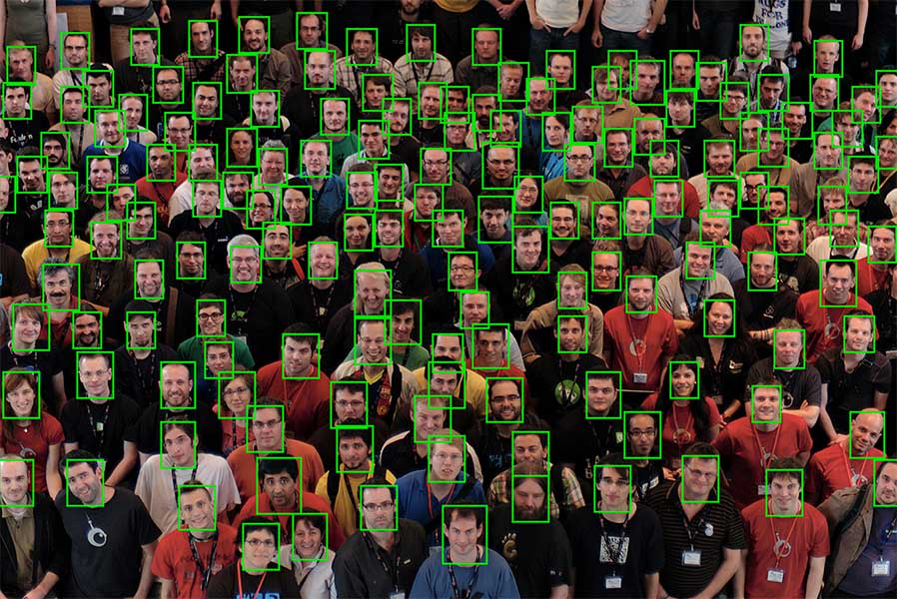
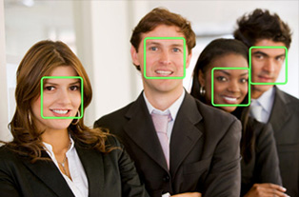
Face Detection
Can be regarded as a specific case of object-class detection.
In object-class detection, the task is to find the locations and sizes of all objects in an image that belong to a given class.
Face-detection algorithms focus on the detection frontal human faces.

Slide 11

How it works
Face detection technology might begin by searching for human eyes. It might do this by testing valley regions in the gray-level image.
Then the genetic algorithm is used to generate all the possible face regions which include eyebrows, irises, nostrils and mouth corners.
Each possible face candidate is normalized to reduce both the lightning effect, which is caused by uneven illumination, and the shirring effect, which is due to head movement.
The fitness value of each candidate is measured based on its projection on the eigen-faces.
After a number of iterations, all the face candidates with a high fitness value are selected for further verification.
At this stage, the face symmetry is measured and the existence of the different facial features is verified for each face candidate.

Slide 12
Viola-Jones object detection framework
Is the first object detection framework to provide competitive object detection rates in real-time.
It can be trained to detect a variety of object classes, but it is generally used to solve the problem of face detection.
The basic principle of this algorithm is to scan a sub-window capable of detecting faces across a given input image.
Viola–Jones requires full view frontal upright faces pointing towards the camera.
It might seems that these constraints could reduce the algorithm's utility somehow, due to the fact that the detection step is often followed by a recognition phase, actually these limits on pose are quite acceptable.

Slide 13
The main characteristics
It must rate frames quite successfully.
2)
For practical applications at least two frames per second must be processed.
3)
The goal is to distinguish faces from non-faces.
1)

Slide 14
Steps
The algorithm has four stages:
Selection of the just mentioned Haar features
Creation of an integral image
Training using Adaboost
Organization in a classifier cascade

Slide 15
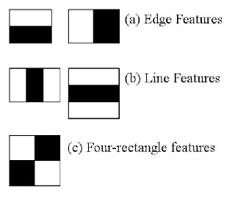
Haar Feature Selection
It is a machine learning based approach where a cascade function is trained from a lot of positive and negative images and it is used to detect objects in other images.
Initially, the algorithm needs a lot of positive images (images of faces) and negative images (images without faces) to train the classifier.
Then we need to extract features from it.
Each feature is a single value obtained by subtracting the sum of pixels under white rectangle from the sum of pixels under black rectangle.
Haar features shown in the following images are used.

Slide 16
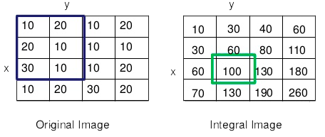
Creation of an Integral Image
For each feature calculation, we need to find the sum of pixels under white and black rectangles.
To solve this, they introduced the integral images.
It simplifies calculation of sum of pixels, how large may be the number of them, making it an operation involving just four pixels.

Slide 17
Adaboost Training
Among all these calculated features, most of them are irrelevant. A fast way to select the best ones out of 160000 (which are contained in a simple 24x24 window) or more is achieved by Adaboost; it selects nearly 6000 images and continues to work on them.
In order to do it, we apply each and every feature on all the training images.
Final classifier is a weighted sum of these weak classifiers.
For each feature, it finds the best threshold which will classify the faces to positive and negative.
Note: It is called weak because it alone can't classify the image, but together with others forms a strong classifier. According to Viola and Jones, even 200 features provide detection with 95% accuracy.

Slide 18
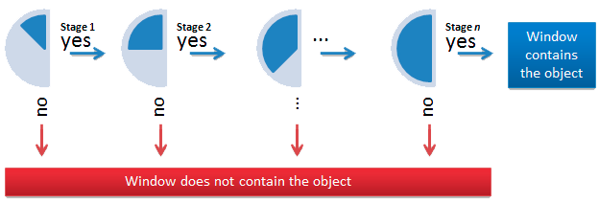
Cascading Classifiers
In an photo, most of the image region is non-face region.
So it is a better idea to have a simple method to check if a window is not a face region. If it is not, the algorithm discard it in a single shot and doesn't process it again.
Instead, it focuses on regions where there can be a face. This way, we can find more time to check a possible face region. For this they introduced the concept of Cascade of Classifiers.
Instead of applying all the 6000 features on a window, group the features into different stages of classifiers and apply one-by-one.
If a window fails the first stage, it is discarded and the remaining features on it aren't considered.
Instead, if it passes, we apply the second stage of features and continue the process. The window which passes all stages is a face region.

Slide 19
Outline
Motivations and goals
Face detection by Viola Jones
Experiments and Results
Problem Faced & Solutions
Final implementation
Conclusions

Slide 20
Experiments and results

Slide 21
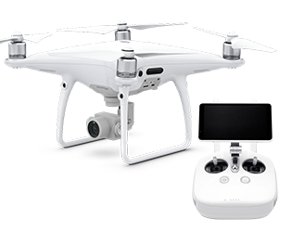
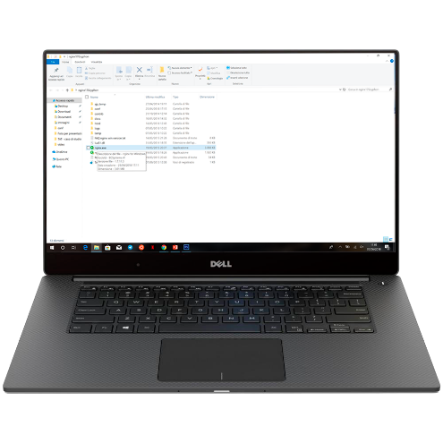
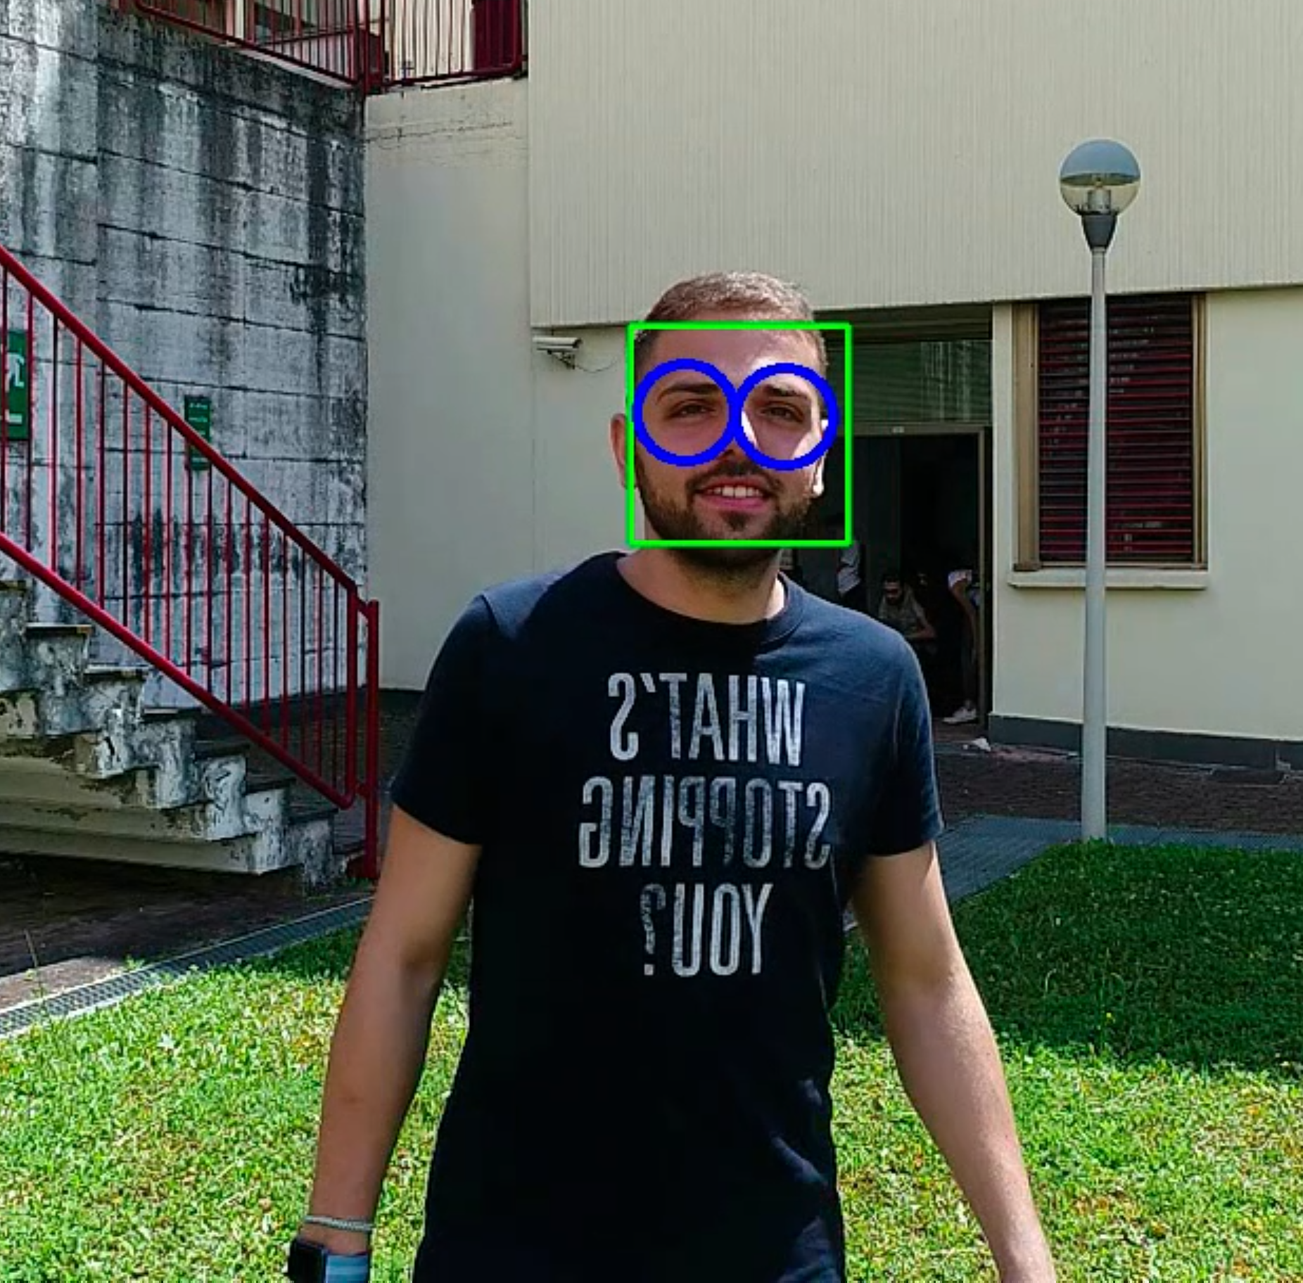
First idea of the system architecture
Drone
Link RTMP
Run server on pc
Run script
Result

Slide 22
Outline
Motivations and goals
Face detection by Viola Jones
Experiments and Results
Problem Faced & Solutions
Final implementation
Conclusions

Slide 23
Problems Faced & Solutions

Slide 24
How to get the video of live streaming?
All we have to find a way to get the video of the live streaming filmed by the Phantom in real time.
We found out that DJIGO4 App can
transmit in several platforms, including YouTube, Facebook, Weibo and in a
customized one.
Our second choice was the latter option offered by the app: it allows you to transmit using RTMP.
The first we tried to use was YouTube.

Slide 25

Solution: RTMP
It was initially a proprietary protocol developed by Macromedia.
Streaming audio, video and data over the Internet.
It uses TCP port number 1935 by default.
TCP-based protocol.
It maintains persistent connections and allows
low-latency communication.
It is used by the Phantom as a platform for customized live streaming.
Example link live: rtmp://172.19.34.63/live/prova.

Slide 26


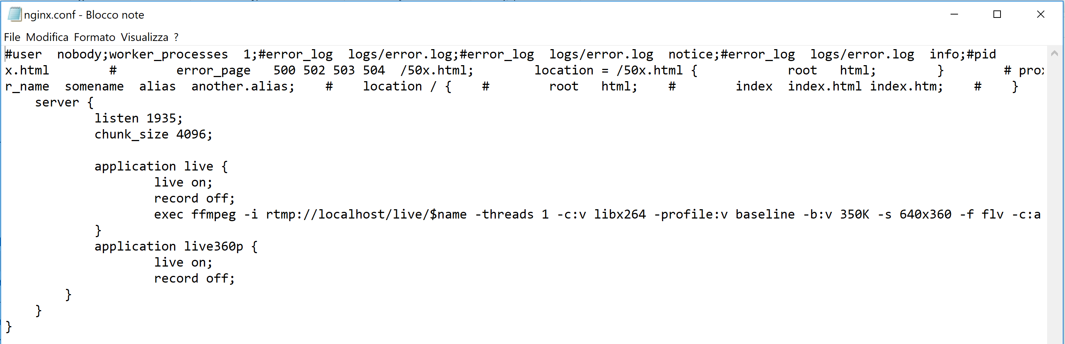
Solution: Server Nginx
It’s a free and open-source software.
Web server.
It can be used as a reverse proxy, load balancer, mail proxy and HTTP cache.
It allows live streaming with RTMP support.
It’s configuration file is «nginx.conf».
We modified it adding ‘server{}’ and other settings.

Slide 27
How to process video?
Python
We searched for way to link RTMP protocol with MATLAB
Ipcam objects come out: they are used to acquire one image frame from an IP camera and display it; but they only works with HTTP or RTSP protocols.
We decided to avoid the problem converting the format of the streaming from RTMP to RTSP.
We didn’t found any software that could make this conversion free.
Vlc + MatLab
Since we were using VLC to test if the streaming was successful, we thought to take advantage of it also to create a connection with MATLAB; again, there was no way to do it.

Slide 28
Libraries
Librtmp
It is a RTMP client library and uses the implementation provided by librtmp via cffi.
It gave us many problems because of the operating system we were using to process the video streaming.
OpenCV library
It appeared as the best solution for our goal.

Slide 29

OpenCV
It is a set of programming functions mainly aimed at real-time computer vision, built to provide a common infrastructure for computer vision applications and to accelerate the use of machine perception in the commercial products.
It was designed for computational efficiency and with a strong focus on real-time applications.
The library has more than 2500 optimized algorithms, which includes a comprehensive set of both classic and machine learning ones.

Slide 30
These algorithms can be used
detect and recognize faces, identify object
classify human actions in videos
track camera movements, track moving objects
extract 3D models of objects, produce 3D point clouds from stereo cameras
A
N
D
M
A
N
Y
O
T
H
E
R
S

Slide 31
Outline
Motivations and goals
Face detection by Viola Jones
Experiments and Results
Problem Faced & Solutions
Final implementation
Conclusions

Slide 32
Final implementation

Slide 33
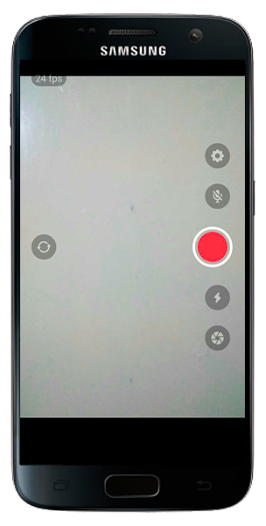
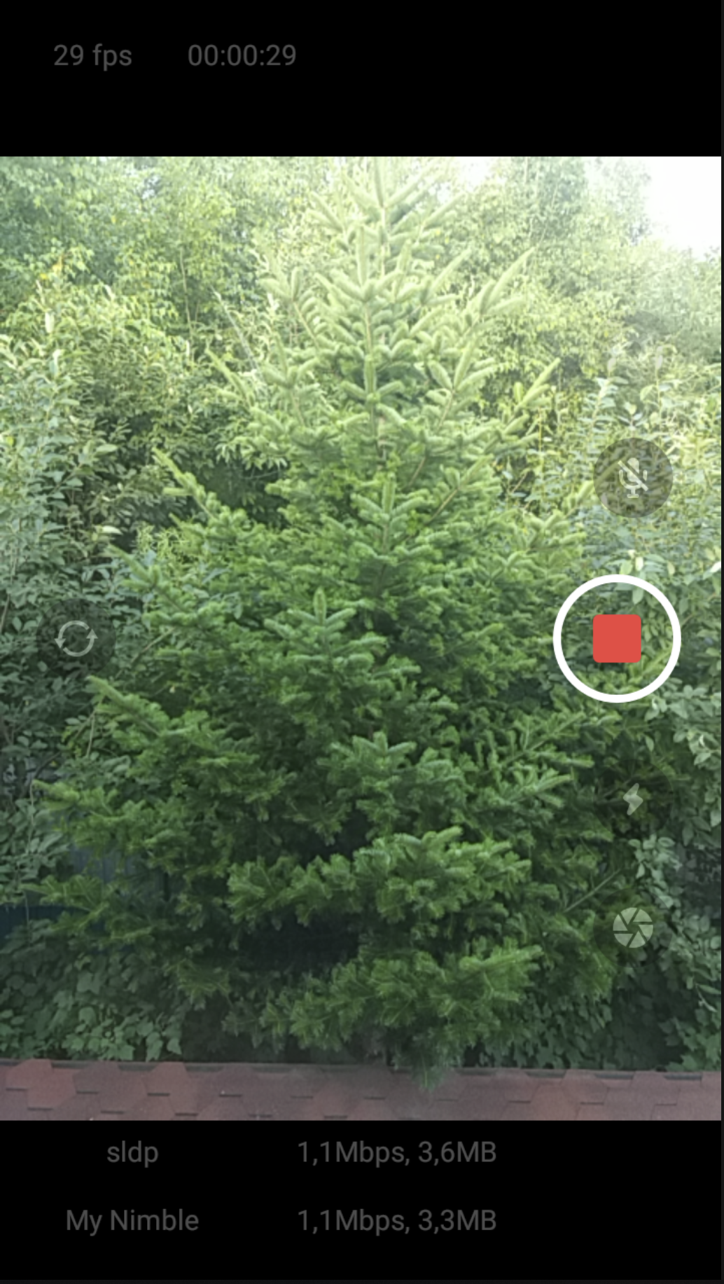
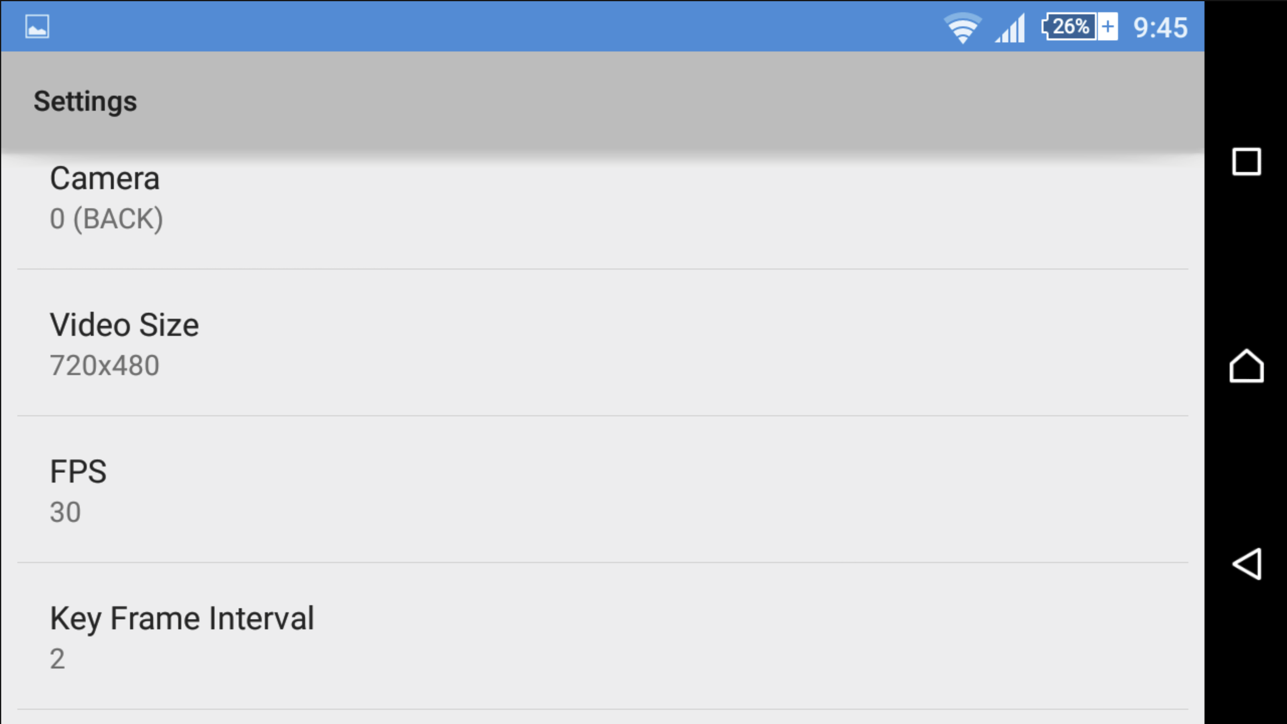

Another tool: Larix Broadcaster
It allows encoding and broadcasting video and/or audio live content from your mobile device in real-time over WiFi, EDGE, 3G or LTE.
Live H.264/AAC encoding.
It supports RTSP and RTMP streaming over TCP.
It saves to MP4 format, making screenshots.
We used it to realize RTMP streaming without taking the drone.

Slide 34
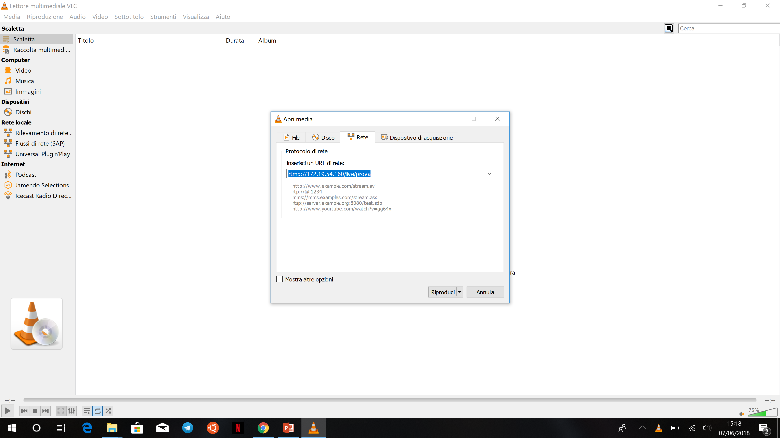
System Architecture
Phantom 4Pro+
Smartphone
with
Larix Broadcaster
or
Live: rtmp://172.19.54.160/live/prova
Run server nginx on pc
Verify if the stream is working using vlc
If it’s ok
run script .py by Anaconda
Result

Slide 35
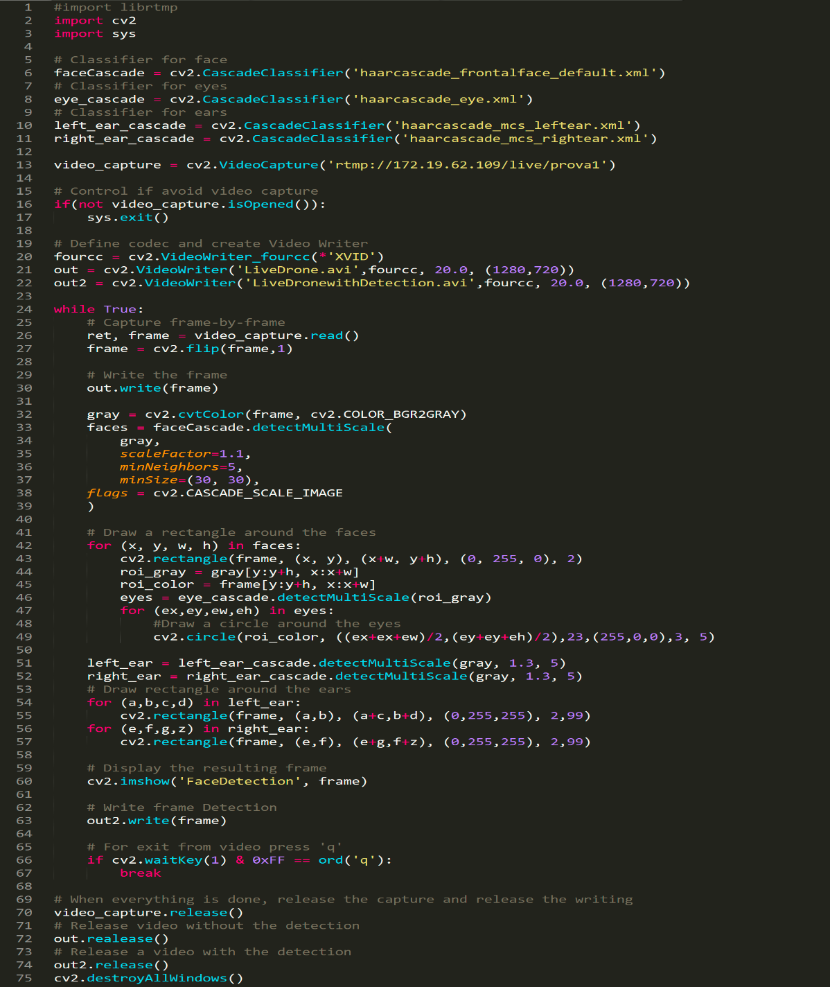
Analysis of the script
Using cv2.CascadeClassifier, we had loaded the classifiers we needed: among all, we chose haarcascade_frontalface_default.xml to detect faces, haarcascade_eye.xml to detect eyes and other two to detect ears, that are haarcascade_mcs_rightear.xml and haarcascade_mcs_leftear.xml.
You need to create a VideoCapture object to capture a video. Its argument can be either the device index or the name of a video file: in our case, it has been the URL network of the live. After that, you can capture frame-by-frame and, at the end, release the capture.
What you need is to save the video. In order to do it, you had to
create a VideoWriter object. You should specify the output file name and the
FourCC code. Then, number of frames per second (fps) and frame size should
be passed; the last one parameter is isColor flag. If it is True, the encoder will expect color frame; otherwise, it works with gray-scale frame.
Again OpenCV's CascadedClassifier has made it simple for us as it comes with the function detectMultiScale, which serves exactly for this purpose. If it finds a face, it returns a list of positions of them in the form Rect(x,y,w,h), If not, then returns none. Some details of its arguments are:
image: the first input is the grayscale image.
scaleFactor: this function compensates a false perception in size that occurs when one face appears to be bigger than the other simply because it is closer to the camera.
minNeighbors: this is a detection algorithm that uses a moving window to detect objects. It defines how many objects can be found near the current one before it can declare the face found.
So, looping over (in a for-loop) the list of faces it returned at the first time, we drew rectangles around faces and circles around eyes on our original colored image, using the following methods: cv.rectangle() and cv.circle(), setting parameters like image, top-left corner and bottom-right corner of rect- angle, color and thickness of the line. Outside it, instead, we drew rectangles around ears.
It opens another window in which it shows the entire face detection in real time.
It ends face detection’s search.

Slide 36

Calculation&Limitation - Delay
Delay due to the server:
Delay due to the calculations of the algorithm:
Total delay:
5-7 seconds, but it depends on the quality of the connection.
About 2 seconds, but it can change according to the processing of the images and to calculating capacity.
About 7-8 seconds.

Slide 37
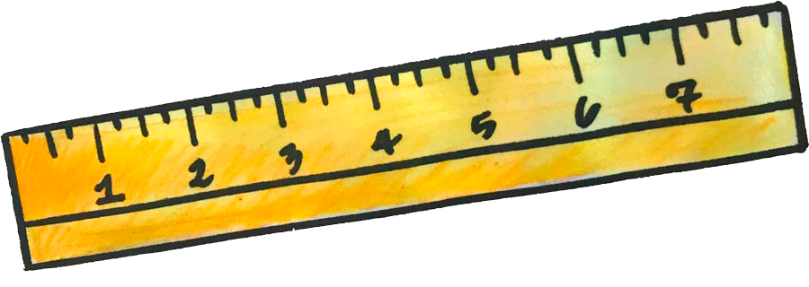
Calculation&Limitation - Distance
Smallest distance required to detect face
Smallest distance required to detect eyes and ears
About 8 metres.
About 1 meter.

Slide 38

Calculation&Limitation – Video resolution
Resolution choosen for the streaming of the drone:
Resolution choosen for smartphone (using Larix Broadcaster):
1280x720 (the smallest it supports).
720x480.

Slide 39
Outline
Motivations and goals
Face detection by Viola Jones
Experiments and Results
Problem Faced & Solutions
Final implementation
Conclusions

Slide 40
Conclusions

Slide 41

Conclusion
Nowadays, there is a great demand for this kind of identication.
In fact, human face is used as a key to security because of various distinct advantages.
So, the aim of the present project became to realize a new biometric system that could help us to distinguish faces and its features.
Its most important components are:
a server - in our case it’s nginx;
a drone - Phantom 4 Pro+;
RTMP protocol;
Computer
If it works, you would see rectangles and circles of different colours surrounding faces, eyes and ears.

Slide 42

Future work
There are several updates that could be done:
A grid on irises in order to identify them better and faster.
Improve the precision in their detection even if a person is far from the camera.
Circles around eyes could modify their size adapting to the face on which they are drawn.
Implement methods to provide face recognition in addition to the detection.

Slide 43
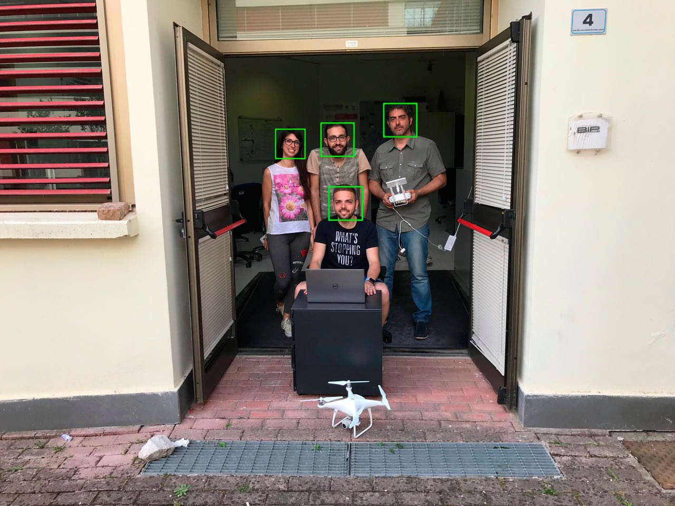
Thanks for the attention.

